Slide 1
Understanding Object Detection
Butterfly Learning

Slide 2
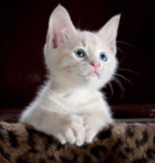
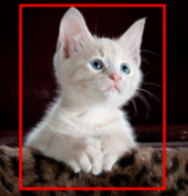
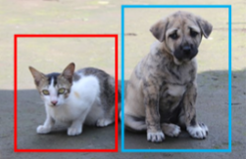
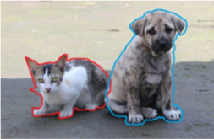
Understanding Object Detection
Classification and Localization
Classification
Object Detection
Image Segmentation
Cat
Cat + Bounding Box
Cat and Dog + Bounding Box
Cat and Dog + Masking
Single Object
Single Object + Localized
Multiple Object + Localized
Multiple Object + Segmented masking
Image Credit: https://www.smartimagingblog.com/2019/03/03/what-can-we-actually-do-with-deep-learning-in-image-processing/
Butterfly Learning

Slide 3
Understanding Object Detection
Classification
MODEL
Classify
Cat or Not
Cat
Single Object
Butterfly Learning

Slide 4
Understanding Object Detection
bx
by
bh
bw
Localize Bounding Box of single object
Classification and Localization
MODEL
Cat + Bounding Box
Classify
Cat or Not
Single Object + Localized
Butterfly Learning

Slide 5
Understanding Object Detection
bx
by
bh
bw
Localize Bounding Box of multiple objects
Object Detection
MODEL
Cat and Dog + Bounding Box
Classify
Multi Classes
Multiple Objects + Localize all objects
Cat and Dog
Butterfly Learning

Slide 6

Follow up Contents
Classical Computer vision
Image matching problem
Corner Detection
SIFT
HOG
Object Classification + localization and Detection Using Classical CV
Dalal and Trigs: HOG + SVM
DPM
CNN based Ideas for Object detection
Butterfly Learning

Slide 7
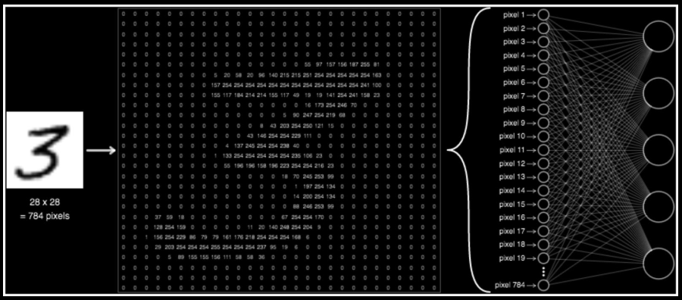
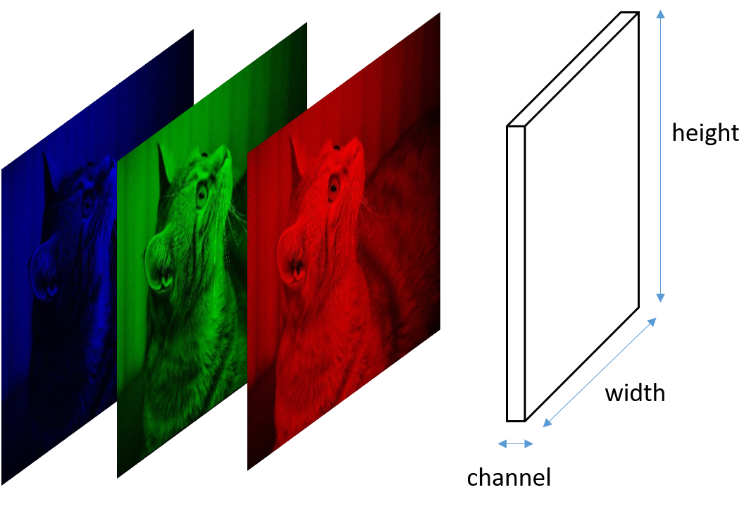
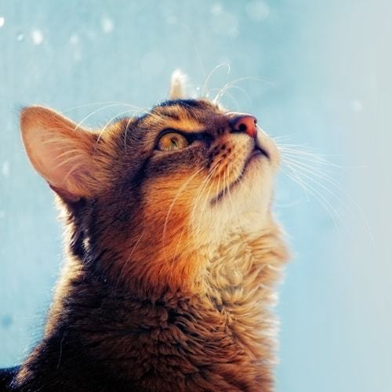
Classical Computer vision: Image matching problem
2-D image
Pixel intensity between 0-255
3-D image
Image Credit: https://www.freepik.com/free-photo/portrait-excited-little-girl-holding-jar-marshmallow_7787831
Butterfly Learning

Slide 8



Classical Computer vision: Image matching problem
Original
Cropped
Cropped + zoom + stretched
Butterfly Learning

Slide 9
Classical Computer vision: Image matching problem
Original
Cropped
Cropped + zoom + stretched
Butterfly Learning

Slide 10
Classical Computer vision: Image matching problem
Original
Cropped
Cropped + zoom + stretched
Butterfly Learning

Slide 11
Classical Computer vision: Image matching problem
Original
Cropped
Cropped + zoom + stretched
Butterfly Learning

Slide 12
Classical Computer vision: Image matching problem
Original
Cropped
Cropped + zoom + stretched
Butterfly Learning

Slide 13


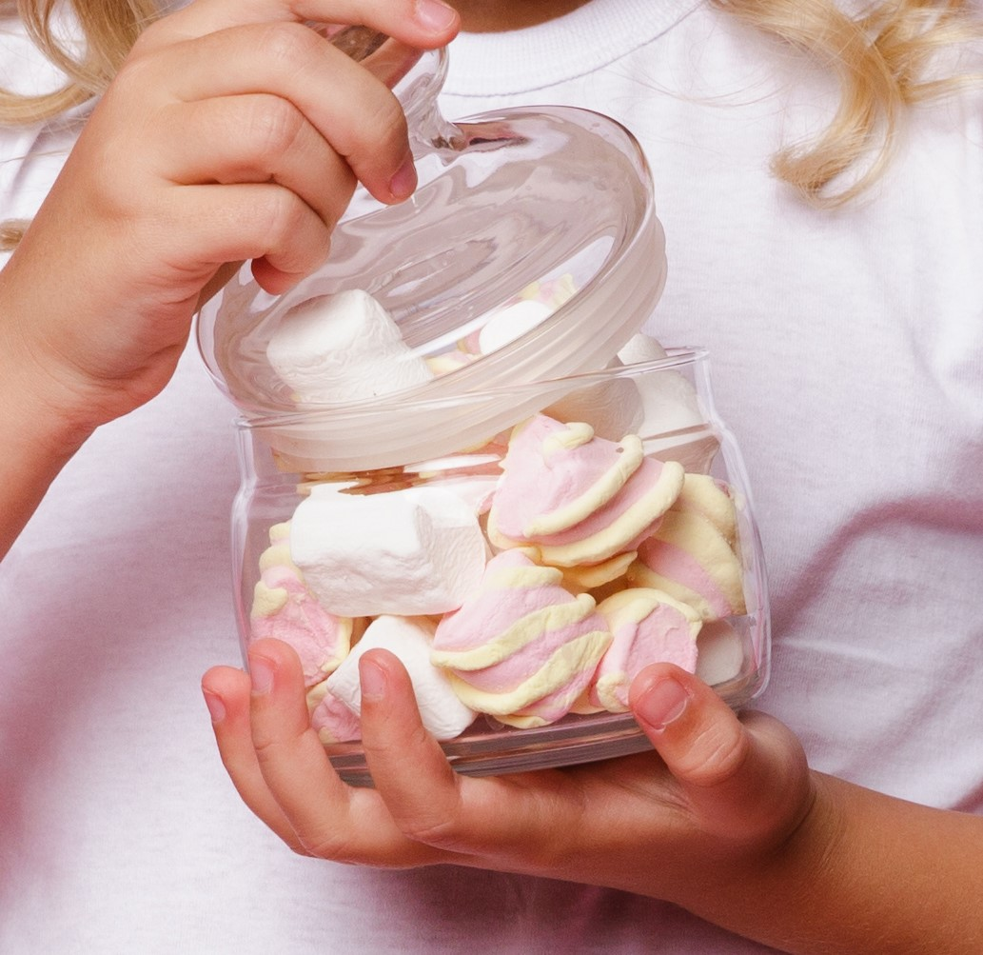
Classical Computer vision: Image matching problem
Original
Cropped
Cropped + zoom + stretched
Cropped jar
Note: Window size is might not exact for illustration
Butterfly Learning

Slide 14
Classical Computer vision: Image matching problem
Original
Cropped
Cropped + zoom + stretched
Cropped jar
Note: Window size is might not exact for illustration
Butterfly Learning

Slide 15
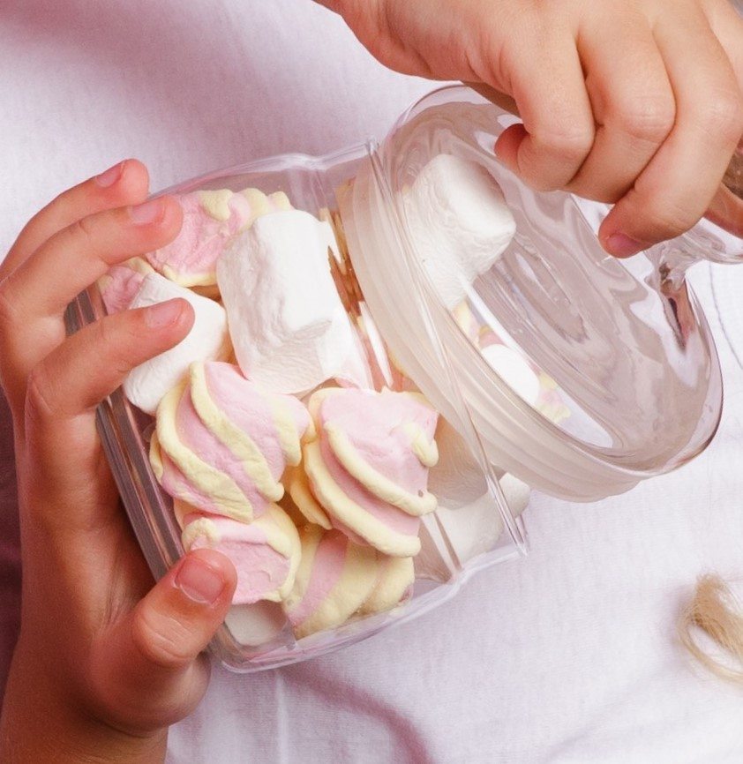
Classical Computer vision: Image matching problem
Original
Cropped
Cropped + zoom + stretched
Cropped jar
Rotated jar
Note: Window size is might not exact for illustration
Butterfly Learning

Slide 16
Classical Computer vision: Image matching problem
Original
Cropped
Cropped + zoom + stretched
Cropped jar
Rotated jar
Note: Window size is might not exact for illustration
Butterfly Learning

Slide 17
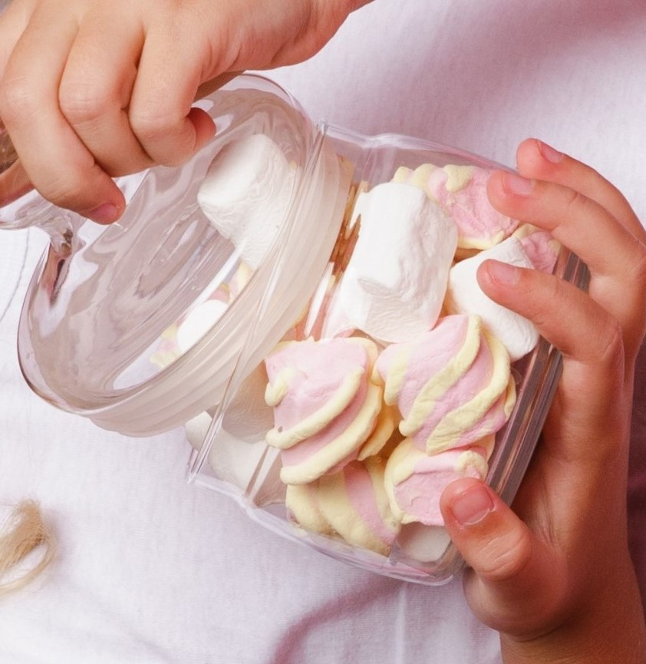
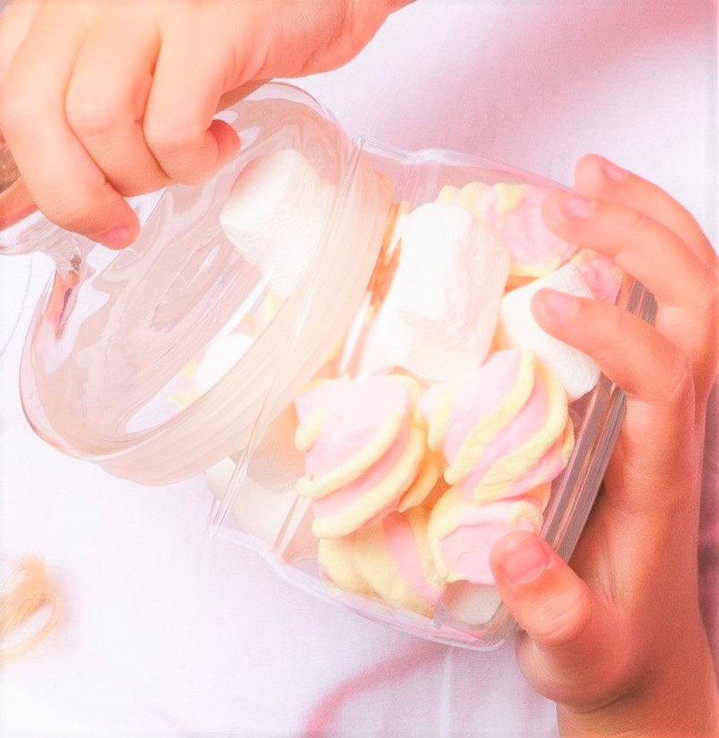
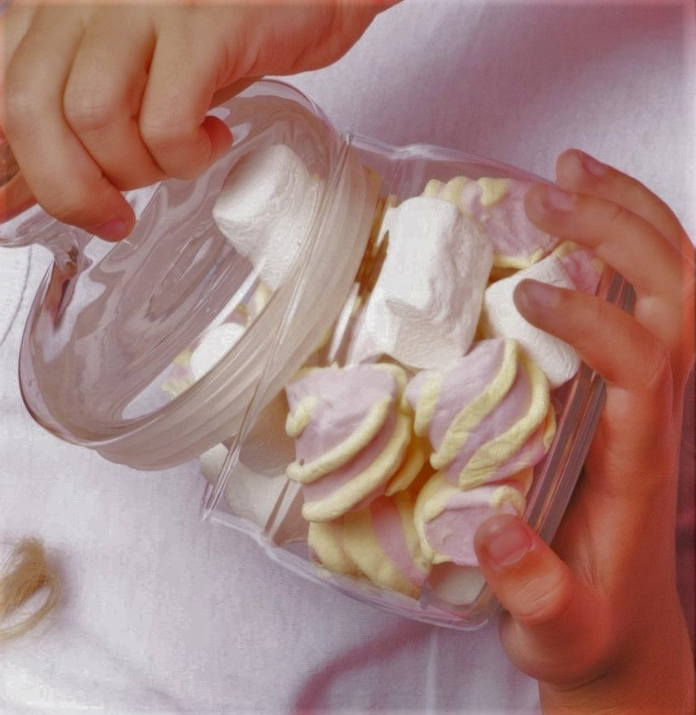
Classical Computer vision: Image matching problem
Original
Cropped
Cropped + zoom + stretched
Cropped jar
Rotated jar
Flipped jar
High brightness
Low brightness
Note: Window size is might not exact for illustration
Butterfly Learning

Slide 18
Classical Computer vision: Image matching problem
Tedious process
Computationally very costly Possibilities of transformation is endless causing which makes it not flexible enough to approach this solution
Any simple Approach?
Butterfly Learning

Slide 19
Image matching problem: Reduce computational Cost – How?
Choose uniform window patches to compare images ?
Butterfly Learning

Slide 20
Image matching problem: Reduce computational Cost – How?
Still a lot of unnecessary background.
Come up with some smart way to find which types of patches window we should be comparing.
Choose uniform window patches to compare images ?
Butterfly Learning

Slide 21
Image matching problem: Reduce computational Cost – How?
How to find out those patches which are important and unique in Nature which will help to determine If a image is same or not?
But first what do I mean by unique patches?
Butterfly Learning

Slide 22
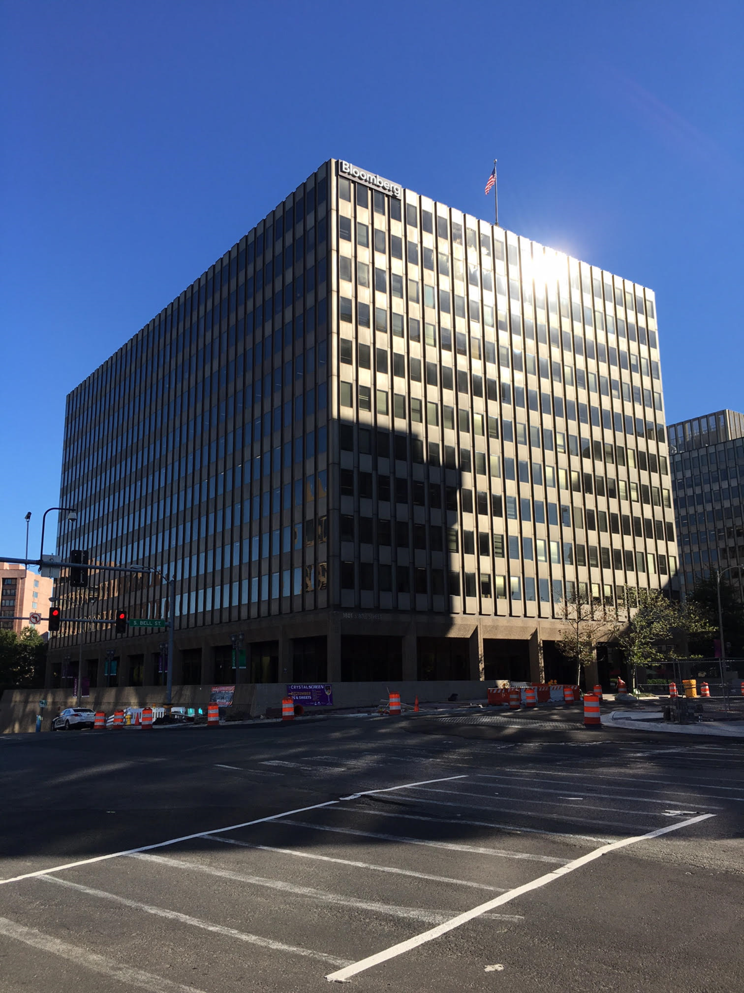


Image matching problem: Reduce computational Cost – How?
But first what do I mean by unique patches?
A
B
C
D
E
F
Find these patches in images
Butterfly Learning

Slide 23
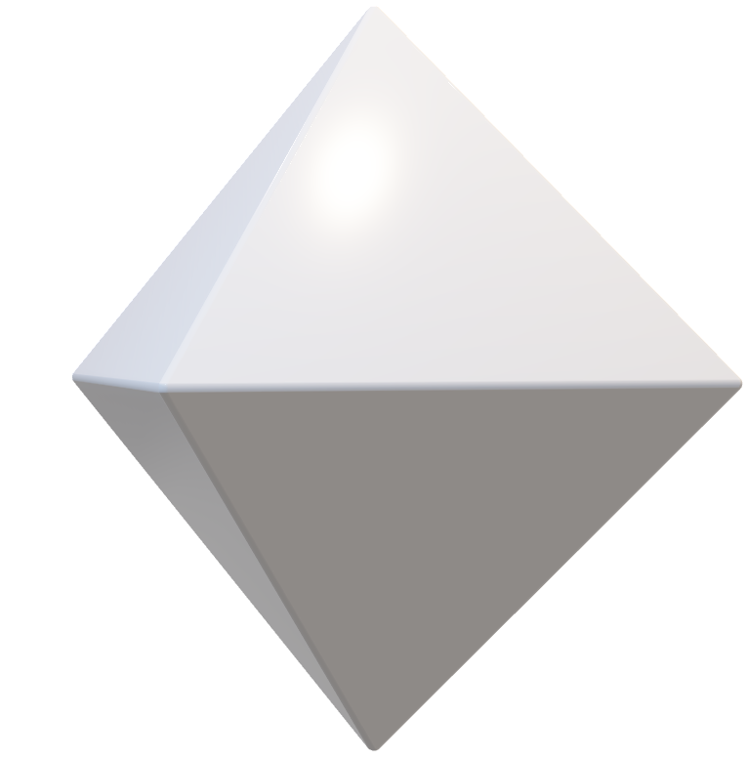
Image matching problem: Reduce computational Cost – How?
Understand the patches problem in more details: How we are able to find unique patches
Plane Patches
Edges
Corners
Butterfly Learning

Slide 24


Image matching problem: Reduce computational Cost – How?
Understand the patches problem in more details: How we are able to find unique patches
Plane Patches
Butterfly Learning

Slide 25
Image matching problem: Reduce computational Cost – How?
Understand the patches problem in more details: How we are able to find unique patches
Plane Patches
Butterfly Learning

Slide 26






Image matching problem: Reduce computational Cost – How?
Understand the patches problem in more details: How we are able to find unique patches
Edges
Horizontal
Butterfly Learning

Slide 27
Image matching problem: Reduce computational Cost – How?
Understand the patches problem in more details: How we are able to find unique patches
Edges
Horizontal
Butterfly Learning

Slide 28
Image matching problem: Reduce computational Cost – How?
Understand the patches problem in more details: How we are able to find unique patches
Edges
Horizontal
Butterfly Learning

Slide 29
Image matching problem: Reduce computational Cost – How?
Understand the patches problem in more details: How we are able to find unique patches
Edges
Horizontal
Vertical
Butterfly Learning

Slide 30
Image matching problem: Reduce computational Cost – How?
Understand the patches problem in more details: How we are able to find unique patches
Edges
Horizontal
Vertical
diagonal
Butterfly Learning

Slide 31





Image matching problem: Reduce computational Cost – How?
Understand the patches problem in more details: How we are able to find unique patches
1
2
Corners
3
4
5
Butterfly Learning

Slide 32
Image matching problem: Reduce computational Cost – How?
Understand the patches problem in more details: How we are able to find unique patches
1
2
Corners
3
4
5
Butterfly Learning

Slide 33
Image matching problem: Reduce computational Cost – How?
Understand the patches problem in more details: How we are able to find unique patches
1
1
2
Corners
3
2
5
3
4
5
4
Butterfly Learning

Slide 34
Image matching problem: Reduce computational Cost – How?
But first what do I mean by unique patches?
A
B
C
D
E
F
Find these patches in images
Butterfly Learning

Slide 35
Image matching problem: Reduce computational Cost – Corner Detection
How to find out those patches which are important and unique in Nature which will help to determine If a image is same or not?
Corner Patches
Butterfly Learning

Slide 36
Image matching problem: Reduce computational Cost – Corner Detection
How to find out those patches which are important and unique in Nature which will help to determine If a image is same or not?
Corner Patches
Butterfly Learning

Slide 37
Image matching problem: Reduce computational Cost – Corner Detection
Original
Cropped
Image Matched
Butterfly Learning

Slide 38
Image matching problem: Reduce computational Cost – Corner Detection
Original
Cropped jar
Butterfly Learning

Slide 39
Image matching problem: Reduce computational Cost – Corner Detection
Original
Cropped jar
Image Matched
Butterfly Learning

Slide 40

Image matching problem: Reduce computational Cost – Corner Detection
Original
Image Matched
Butterfly Learning

Slide 41
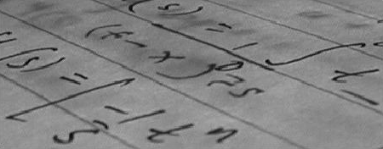
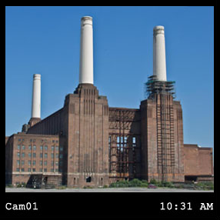
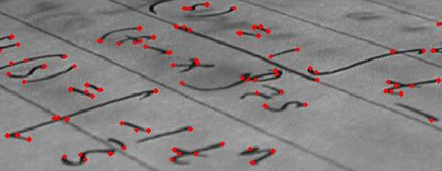
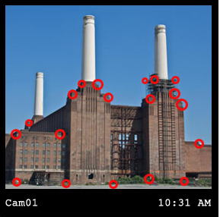
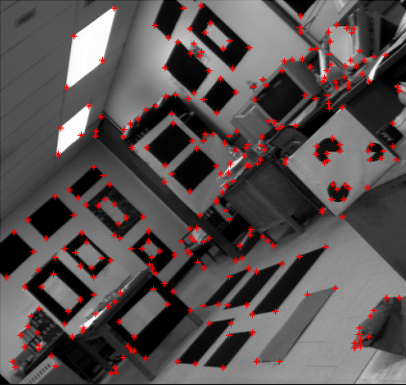
Corner Detection: Examples
Original
Original
Corner detected
Corner detected
Corner detected
Harris Corner detection
Butterfly Learning

Slide 42
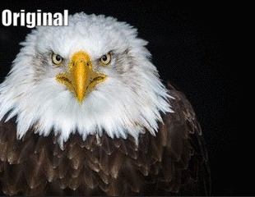
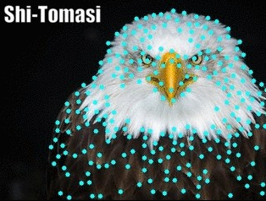
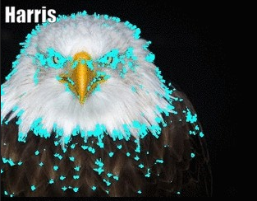
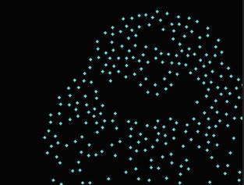
Corner Detection: Examples
Corners Detected
Butterfly Learning

Slide 43
Problem with Corner Detection
Cropped jar
Feature Extracted from rotated image is different but ideally it should be same.
Not Rotation Invariant.
Cropped + Rotated jar
Butterfly Learning

Slide 44
Problem with Corner Detection
Stretched Image
Butterfly Learning

Slide 45
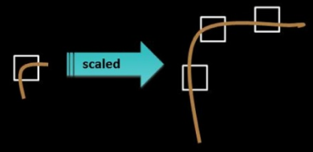
Problem with Corner Detection
Stretched Image
Not able to detect Corner if corner is stretched way more than window size.
Not Scale Invariant.
Butterfly Learning

Slide 46
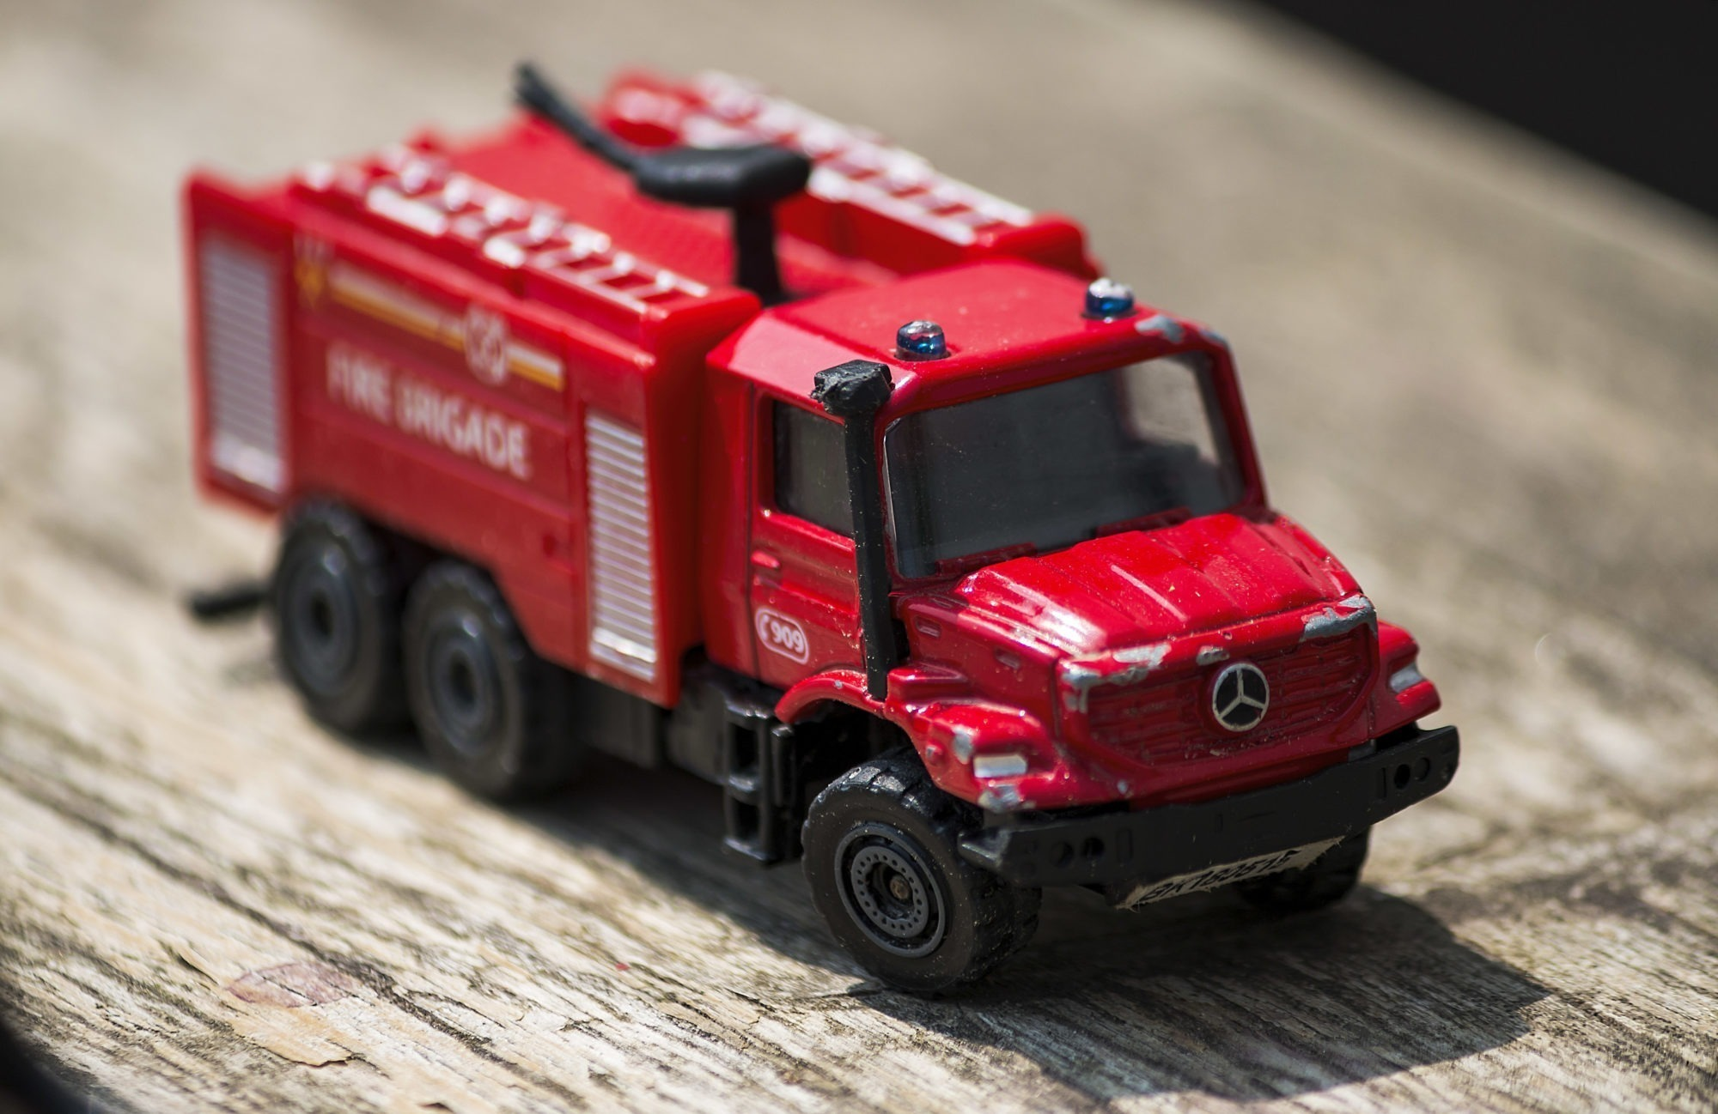
Overcome the problem of Corner Detection - SIFT
Problem with Corner Detection
Rotation variant
Scale Variant
SIFT - Scale Invariance Feature Transform
Rotation Invariant
Scale Invariant
Feature Extraction
Mathematical Transformation
FFT
Feature Vector
Butterfly Learning

Slide 47

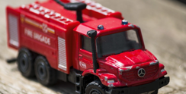
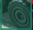
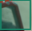
SIFT Intuition
Query Image
Original Image
SIFT Features
Image Matched
Butterfly Learning

Slide 48
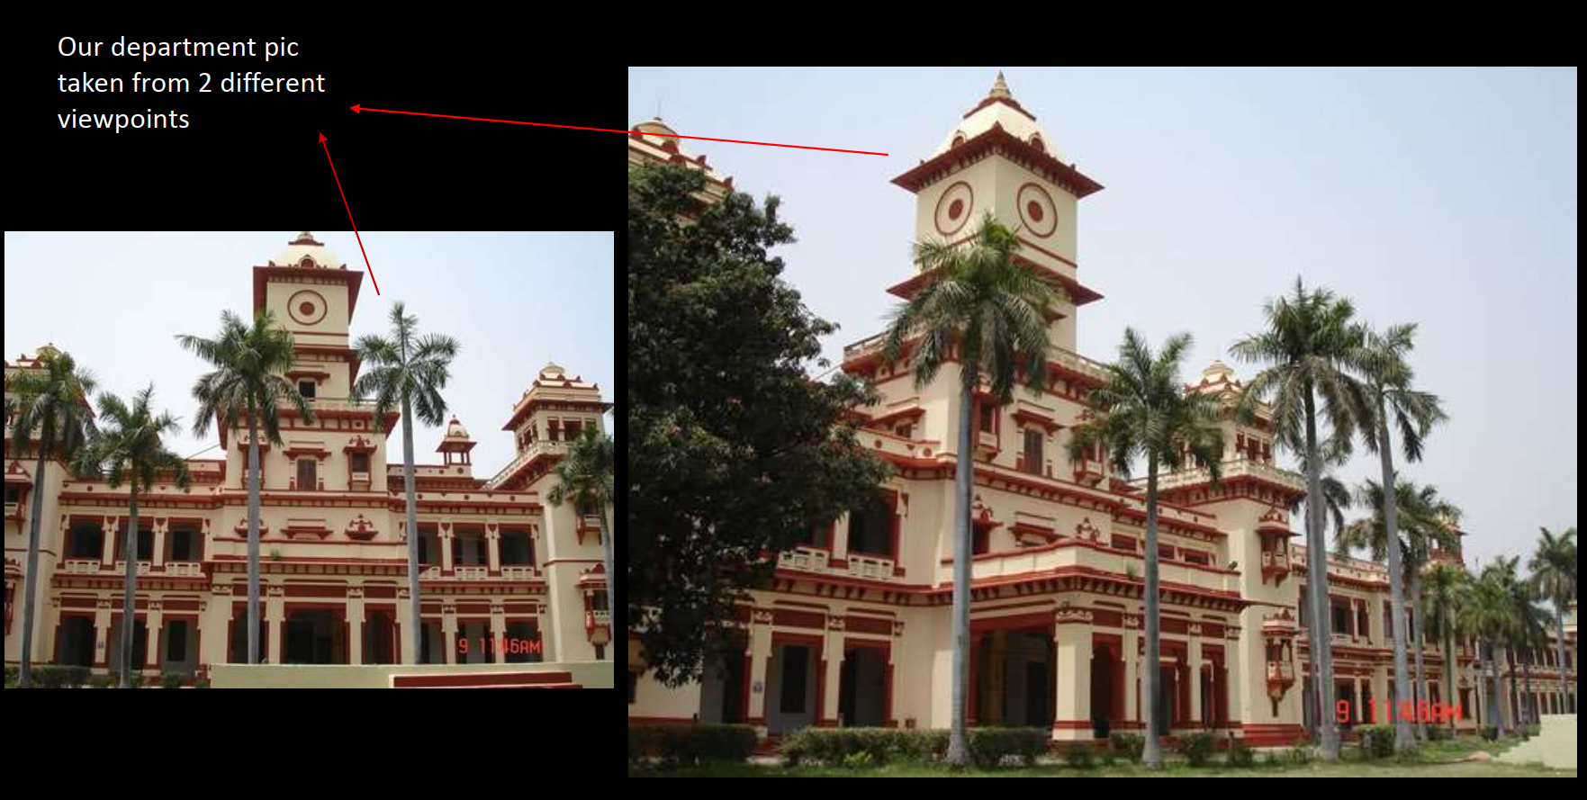
SIFT - Examples
Credit: https://www.slideshare.net/kislayabhi/sift-41469195
Butterfly Learning

Slide 49
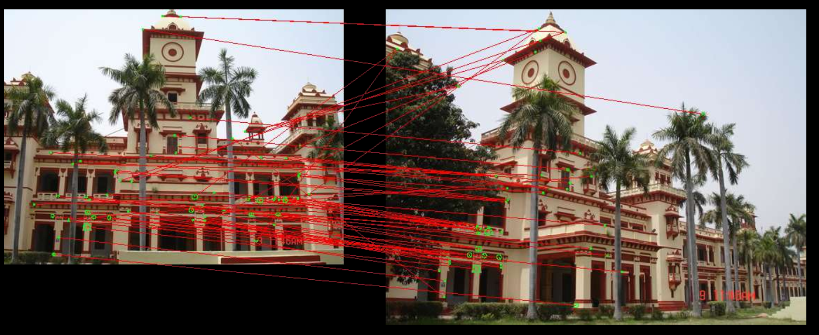
SIFT - Examples
Image Matched
Credit: https://www.slideshare.net/kislayabhi/sift-41469195
Butterfly Learning

Slide 50
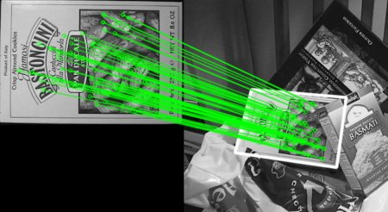
SIFT - Examples
SIFT Advantage
Scale Invariant
Rotation Invariant
Brightness Invariant
Contrast Invariant
Original image
Query image
Image Matched
Credit: https://docs.opencv.org/3.0-beta/doc/py_tutorials/py_feature2d/py_feature_homography/py_feature_homography.html
Butterfly Learning

Slide 51
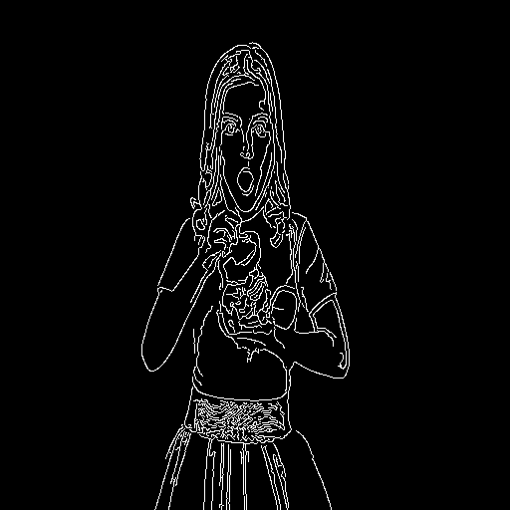
Does that mean?
Original Image
Dense Sampling
Yes, these types of features are also important.
Details in the later slides.
Edge Detection
Butterfly Learning

Slide 52
SIFT – Feature Extraction
Feature Extraction
Mathematical Transformation
FFT
How does these features got extracted ?
NOTE: We will not see exact SIFT algorithm, rather a small aspect of SIFT algorithm that is HOG

Slide 53
HOG - Histogram of Oriented Gradients - Intuition
Magnitude of change in contrast
+
Direction of change in contrast
0
0.5
1
0.5 - 1
Tutorial Credit: Cogneeti
Butterfly Learning

Slide 54
HOG - Histogram of Oriented Gradients - Intuition
Magnitude of change in contrast
+
Direction of change in contrast
0
0.5
1
0.5 - 1
Tutorial Credit: Cogneeti
Butterfly Learning

Slide 55
HOG - Histogram of Oriented Gradients - Intuition
Magnitude of change in contrast
+
Direction of change in contrast
0
0.5
1
0.5 - 1
Tutorial Credit: Cogneeti
Butterfly Learning

Slide 56
HOG - Histogram of Oriented Gradients - Intuition
Magnitude of change in contrast
+
Direction of change in contrast
0
0.5
1
0.5 - 1
Tutorial Credit: Cogneeti

Slide 57
HOG - Histogram of Oriented Gradients - Intuition
Magnitude of change in contrast
+
Direction of change in contrast
0
0.5
1
0.5 - 1
Tutorial Credit: Cogneeti
Butterfly Learning

Slide 58
HOG - Feature Extraction
1:2 Aspect ratio
1:2 Aspect ratio
150 X 300
Resize to 64 X 128
Butterfly Learning

Slide 59
HOG - Feature Extraction
40
60
30
k1
70
30
60
30
20
80
8
16
Resized image 64 X 128
Divide image into
8 X 16 blocks
8 X 16 blocks
8 X 8 grids each block
8 X 16 blocks
Butterfly Learning

Slide 60
30
Calculate Gradients at x - axis and y - axis
X – axis :
Gx = | X2 - X1 | = | 70 - 60| = 10
Y – axis :
Gy = | Y2 - Y1 | = | 60 - 20| = 40
40
60
k1
70
30
60
40 | 60 | 30
70 | 30 | 60
30 | 20 | 80
30
20
80
16
16
Calculate Gradient magnitude
G = sqrt( (Gx)² + (Gy)² )
Sqrt ( (10)² + (40)² ) ~ 41
16 X 16 blocks
8 X 8 grids each block
k1
k1
41
88
Calculate Gradient Direction
Θ = arctan (Gx/Gy) = tan ⁻¹ (41) ~ 88°
Gradient Magnitude
Gradient Direction
Butterfly Learning

Slide 61
HOG - Feature Extraction
40
60
30
k1
k1
k1
70
30
60
41
88
30
20
80
16
40
40
40
40
20
40
30
25
Gradient Magnitude
Gradient Direction
16
Feature Vector
9 x 1 Feature Matrix
0 -20º
20-40º
40 -60º
60 -80º
80 -100º
100 - 120º
120 - 140º
140 - 160º
160 - 180º
Butterfly Learning

Slide 62
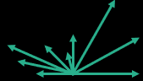
HOG - Feature Extraction
k1
k1
41
88
40
40
40
40
16
20
40
30
25
16
Gradient Magnitude
Gradient Direction
16
16
9 x 1 Feature Matrix
8 x 16 block
Each having 9 x 1 Feature vector
Butterfly Learning

Slide 63
HOG - Feature Extraction
Normalize
Normalize – Why?
2
4
4
8
Brightness Invariant
Contrast Invariant
8 x 16 block
Each having 9 x 1 Feature vector
Normalized 8 x 16 block
Each having 9 x 1 Feature vector
Butterfly Learning

Slide 64
HOG - Feature Extraction
16
16
Resized image 64 X 128
Divide image into
8 X 16 blocks
8 X 8 grids each block
8 X 16 blocks
9 X 1 HOG features each block
Normalized 8 x 16 x 9 x 1
HOG Feature Vectors
Butterfly Learning

Slide 65
HOG - Feature Extraction
50 % Overlap of 2X2 Blocks
2X2
2x2x9x1 = 36 features
Concatenation of 2X2 Blocks
Normalized 7 x 15 block
Each having 36 X 1 Feature vector
Total : 7 X 15 X 36 X 1 = 3708
Normalized 8 x 16 block
Each having 9 x 1 Feature vector

Slide 66
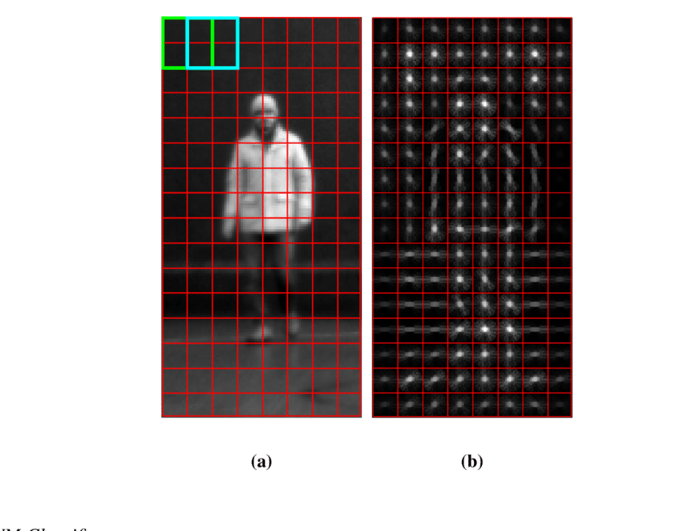
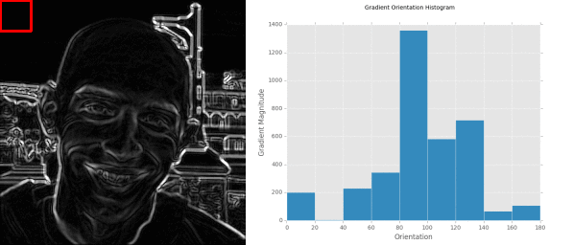
HOG - Feature Extraction
ILLUSTRATION OF HOG
Input
HOG calculation
Input
HOG Features
Image credit : https://gurus.pyimagesearch.com/lesson-sample-histogram-of-oriented-gradients-and-car-logo-recognition/
Butterfly Learning

Slide 67

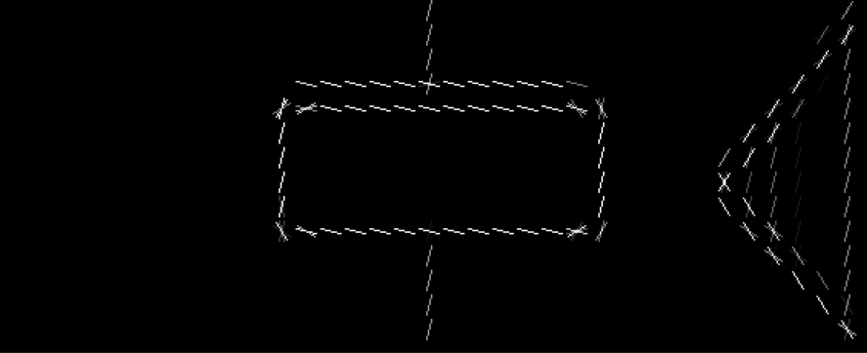
HOG - EXAMPLES
Input Image
HOG features
Code credit: https://iq.opengenus.org/object-detection-with-histogram-of-oriented-gradients-hog/
Butterfly Learning

Slide 68
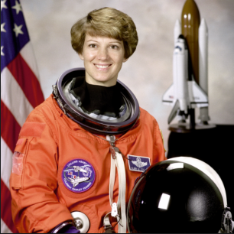
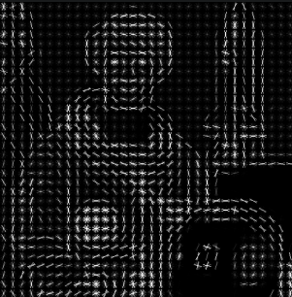
HOG - EXAMPLES
Input Image
HOG features
Code credit: https://iq.opengenus.org/object-detection-with-histogram-of-oriented-gradients-hog/
Butterfly Learning

Slide 69
Follow up Contents
Classical Computer vision
Image matching problem
Corner Detection
SIFT
HOG
Object Classification + localization and Detection Using Classical CV
Dalal and Trigs: HOG + SVM
DPM
CNN based Ideas for Object detection
Butterfly Learning

